Slide 1

CMR COLLEGE OF ENGINEERING & TECHNOLOGY
Kandlakoya, Medchal, Hyderabad - 501401
Department of Computer Science and Engineering
DROWSINESS DETECTION SYSTEM
23H51D5803 D.SATHISH
Under esteemed guidance of:
Dr. G. Ravi Kumar (Associate Professor)

Slide 2
Outline
Abstract
Introduction
Literature survey
Objective
Technologies used
Proposed System
Result
Conclusion
References
Notes:
2

Slide 3
Abstract
Notes:
3

Slide 4
ABSTRACT
Drowsy driving is a major cause of accidents. This project presents a system that analyzes uploaded images of drivers to detect drowsiness using eye closure duration and blink frequency. The system employs image processing and machine learning to calculate the Eye Aspect Ratio (EAR) for alertness detection.
Featuring an easy-to-use interface for image uploads, the system alerts drivers if drowsiness is detected. With data from public and custom sources, the system achieves a 92% accuracy rate. This solution offers a practical approach to enhancing road safety by reducing accidents from driver fatigue.

Slide 5
INTRODUCTION
Notes:
5

Slide 6
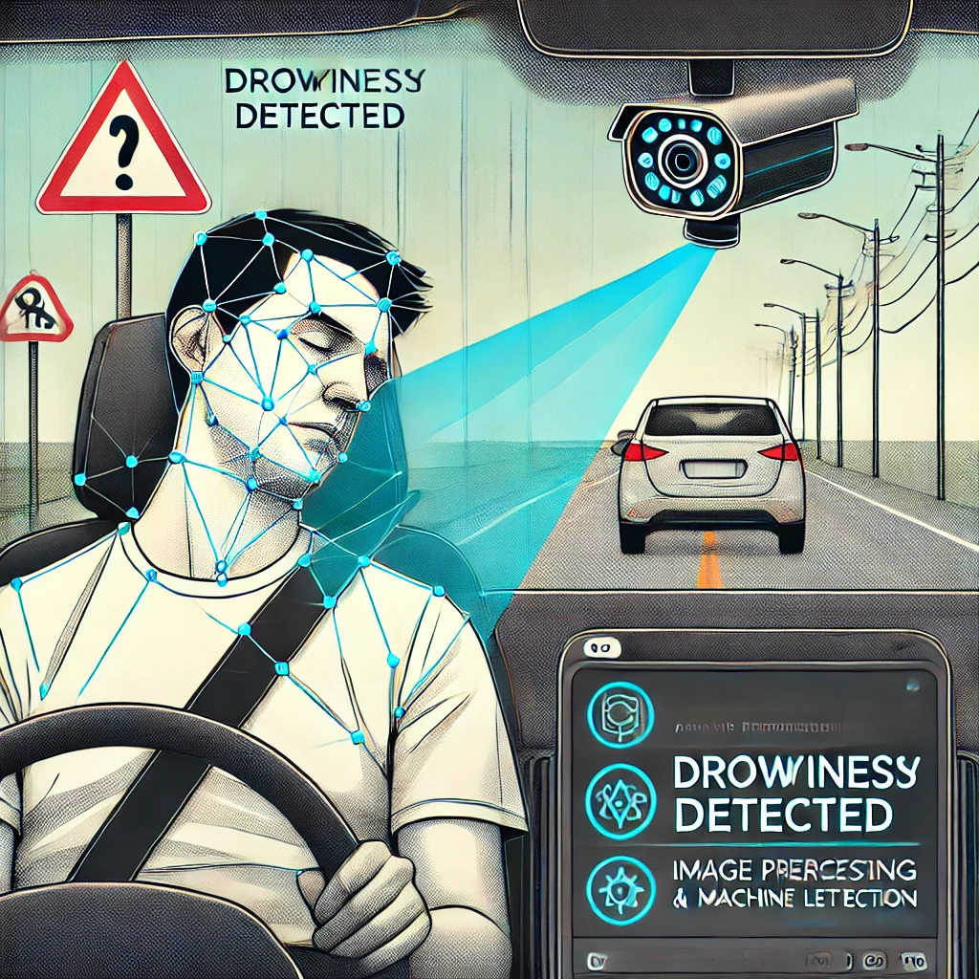
Introduction
Purpose: Develop a system to detect driver drowsiness from uploaded images.
Importance:
Drowsy driving is a major cause of road accidents and fatalities.
Early detection can prevent accidents and save lives.
Objectives:
Create an accurate detection system using image processing and machine learning.
Provide a user-friendly interface for image upload and alerting drivers.
Notes:
6

Slide 7
Literature Survey
Notes:
7

Slide 8
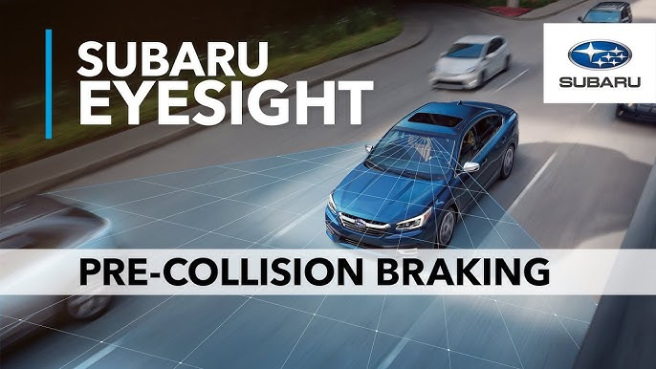
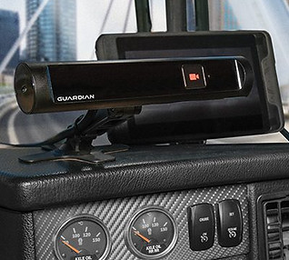
Existed system
EyeSight Driver Assist Technology (Subaru):
Subaru's EyeSight Driver Assist Technology includes features such as lane departure warning, adaptive cruise control, and pre-collision braking. It also incorporates a driver monitoring system that tracks eye movements and alerts the driver if signs of drowsiness or distraction are detected.
Seeing Machines Guardian System:
The Seeing Machines Guardian System is an in-cabin monitoring system designed for commercial vehicles and heavy machinery. It uses specialized cameras and machine learning algorithms to detect signs of driver fatigue or distraction, providing immediate alerts to fleet operators.
Notes:
8

Slide 9

Existed system
Problems in existing system:
Accuracy Variation: Performance may vary under different lighting and driver conditions.
Image Quality Dependency: System accuracy heavily relies on high-quality image uploads.
Real-time Processing Constraints: Challenges in real-time processing speed and efficiency.
Demographic Variability: Effectiveness may differ across diverse driver demographics.
Usability Concerns: User interface and alert mechanism may need enhancement for clearer feedback.
Privacy and Security Risks: Handling sensitive driver data requires robust privacy measures.
Integration and Maintenance: Ensuring seamless integration and ongoing system maintenance.
Notes:
9

Slide 10
Objective
Notes:
10

Slide 11

Objective
Developing an Automated Drowsiness Detection System: The primary objective of the project is to develop an automated system capable of detecting signs of drowsiness in drivers using computer vision techniques.
Accurate Detection: Ensure the system can accurately differentiate between alert and drowsy states by analyzing key indicators such as eyelid behavior and Eye Aspect Ratio (EAR).
User-friendly Interface: Develop a graphical user interface (GUI) that is intuitive and non-distracting, allowing for easy interaction with the system and providing clear feedback to the driver.

Slide 12
Problem Definition
Notes:
12

Slide 13
Problem Definition
The existing system is doing all the processes manually.The administrator should refer all the records kept for years ago to simply know details.This so tedious and time consuming.
This process is so difficult when the number of users increases.
The students are not being made aware of the Training and Placement activity hence there might have been loss of opportunities.
Developing a web application which will be help full for students to recive all kinds of information regarding placements and trainings viz. this application has ability to allow students to ask queries and get them resolving there it self.

Slide 14
Research Work
Notes:
14

Slide 15


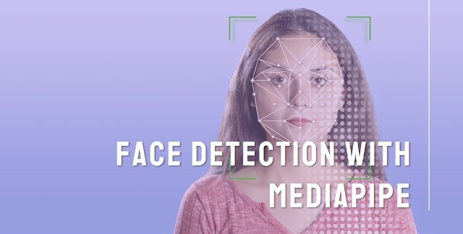
Technologies used
Used for image processing and manipulation.
Python
Used for real-time facial landmark detection
The entire project is implemented in Python, a versatile and widely-used programming language that offers extensive libraries and frameworks for computer vision, machine learning, and GUI development.
Notes:
15

Slide 16
Proposed System
Overview:
The user uploads an image through the UI.
The image processing module prepares the image for analysis.
The drowsiness detection module analyzes the image to determine if the user is drowsy.
If drowsiness is detected, the alert mechanism generates visual and auditory alerts.
The integration module ensures smooth communication and data transfer between components.

Slide 17
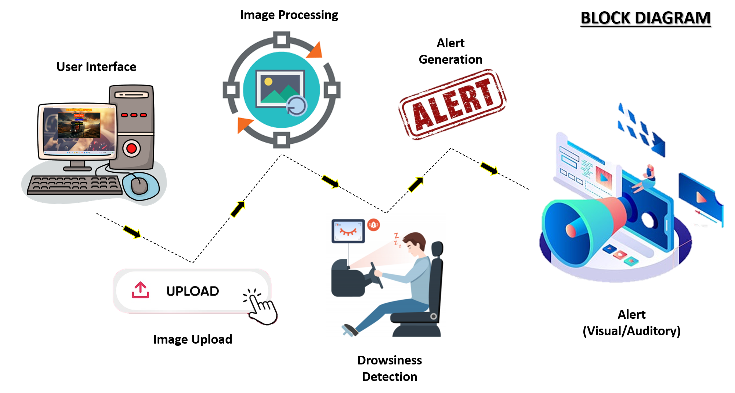

Slide 18
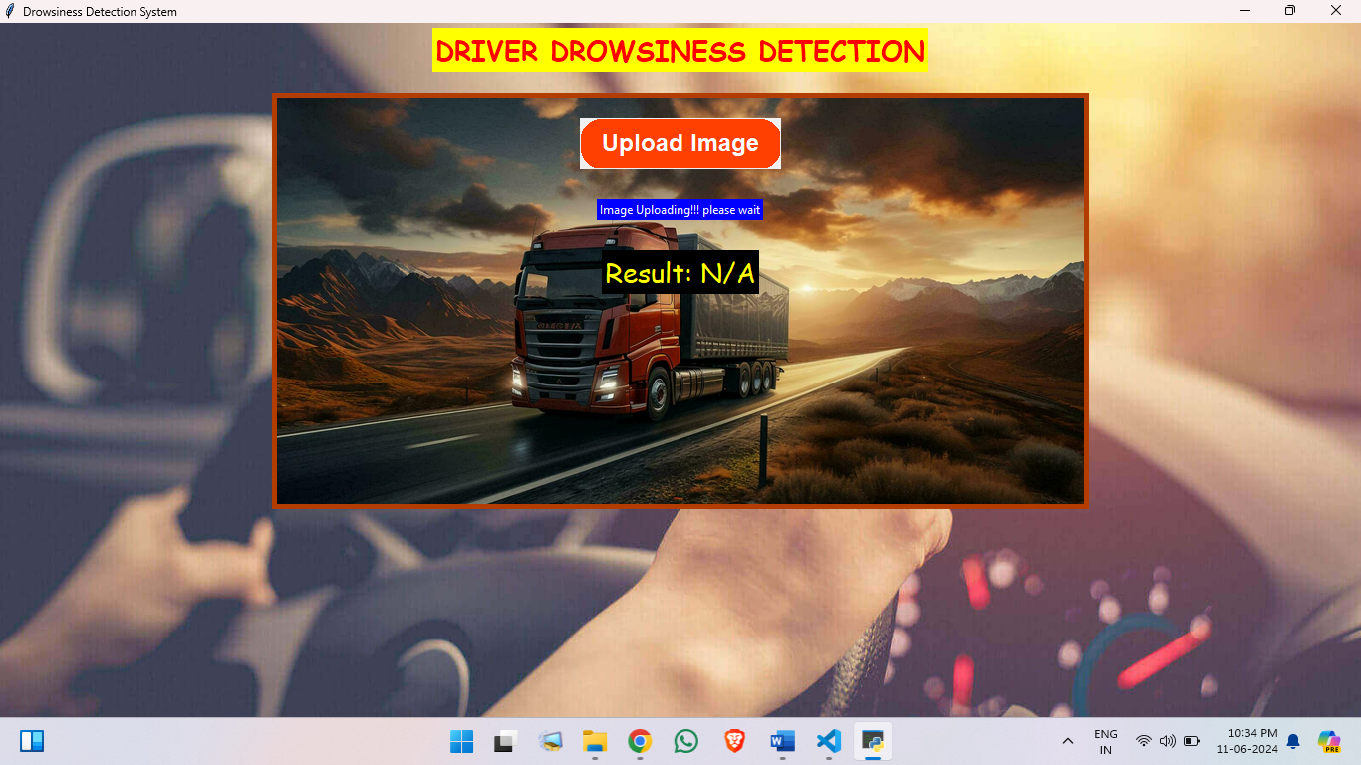
Result
DASHBOARD

Slide 19
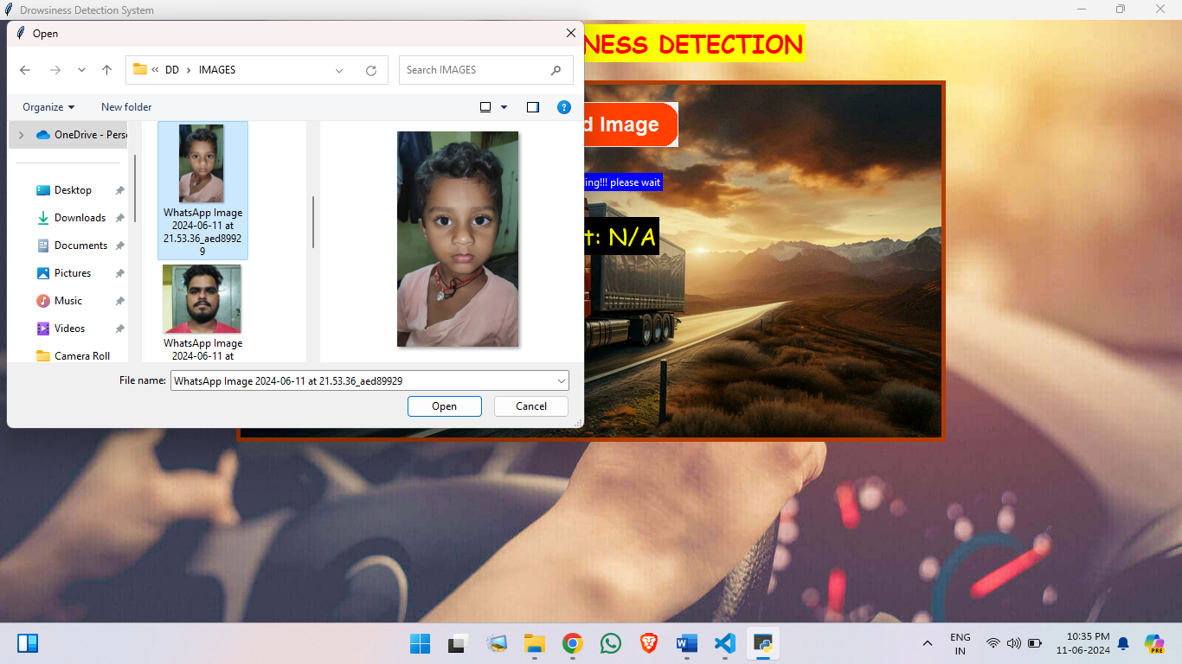
UPLOADING IMAGE

Slide 20
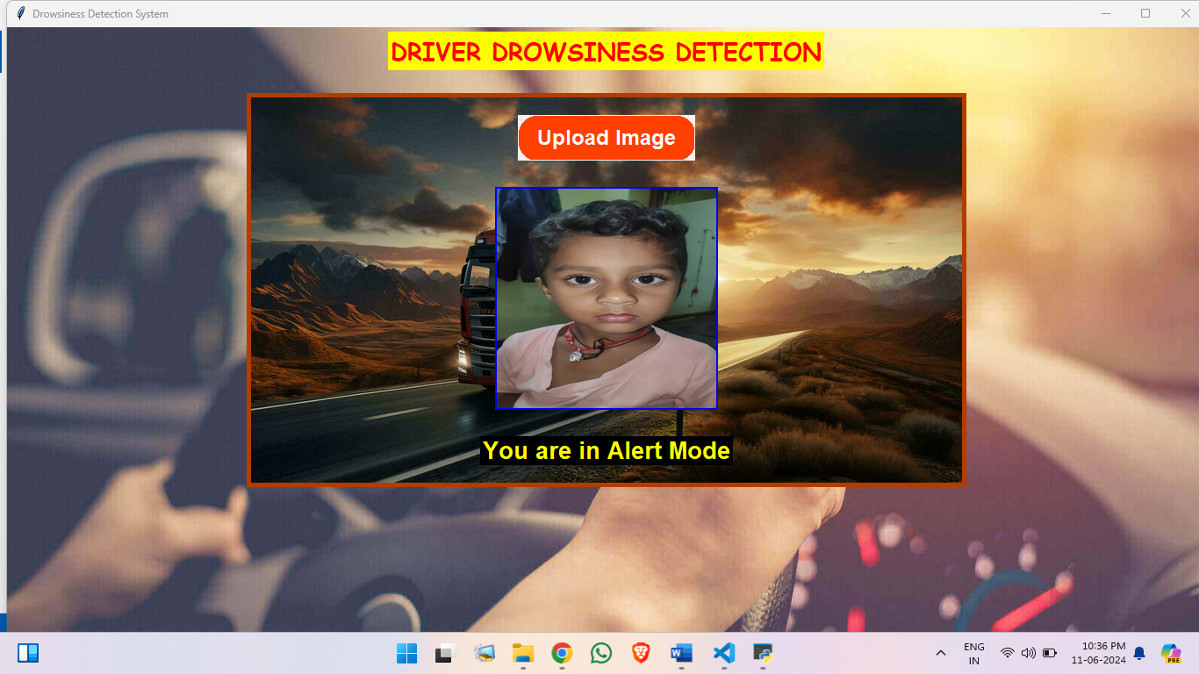
Image uploaded and detected

Slide 21
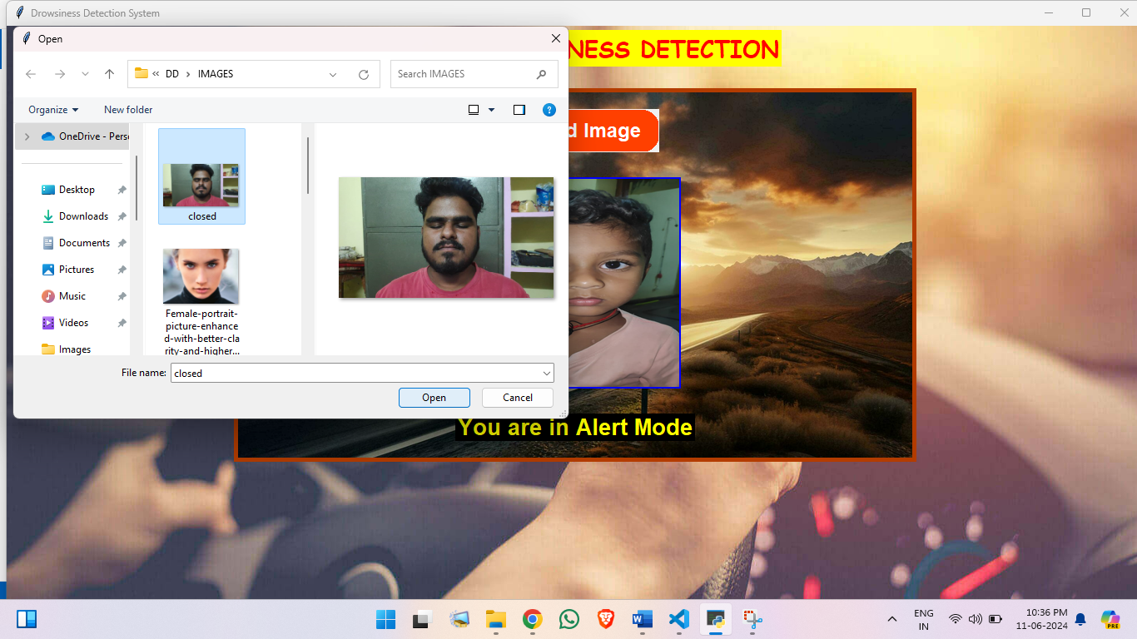
Next Image uploading

Slide 22
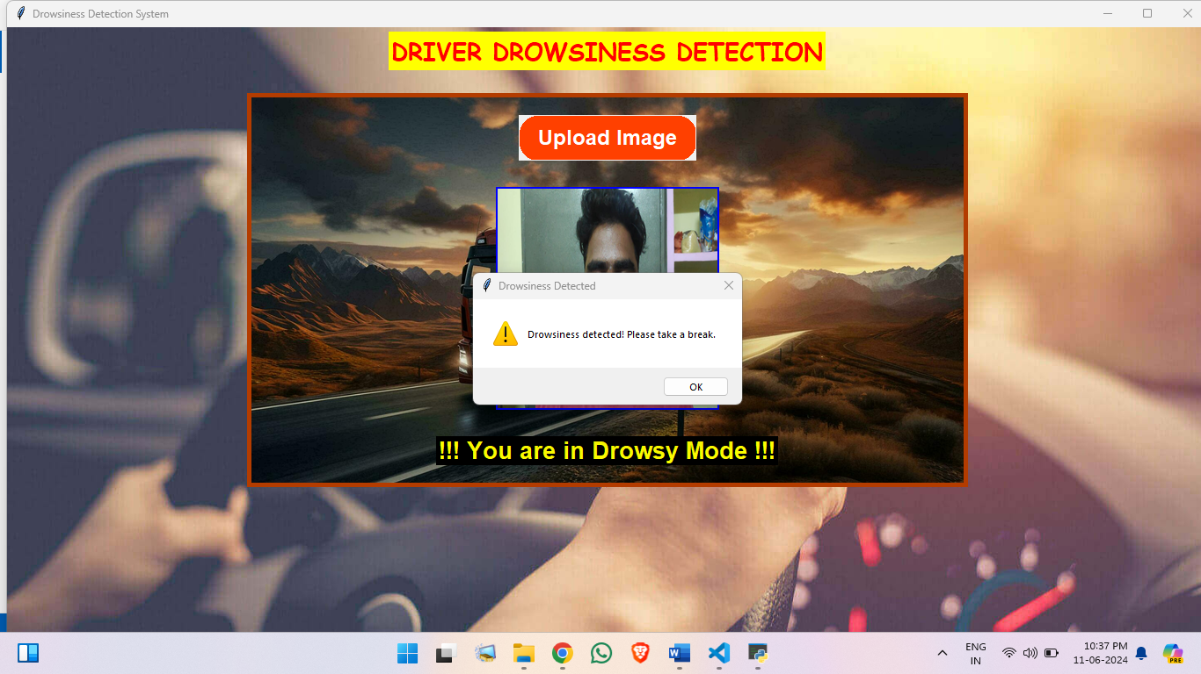
Image Detection and giving alert with audio and statement

Slide 23
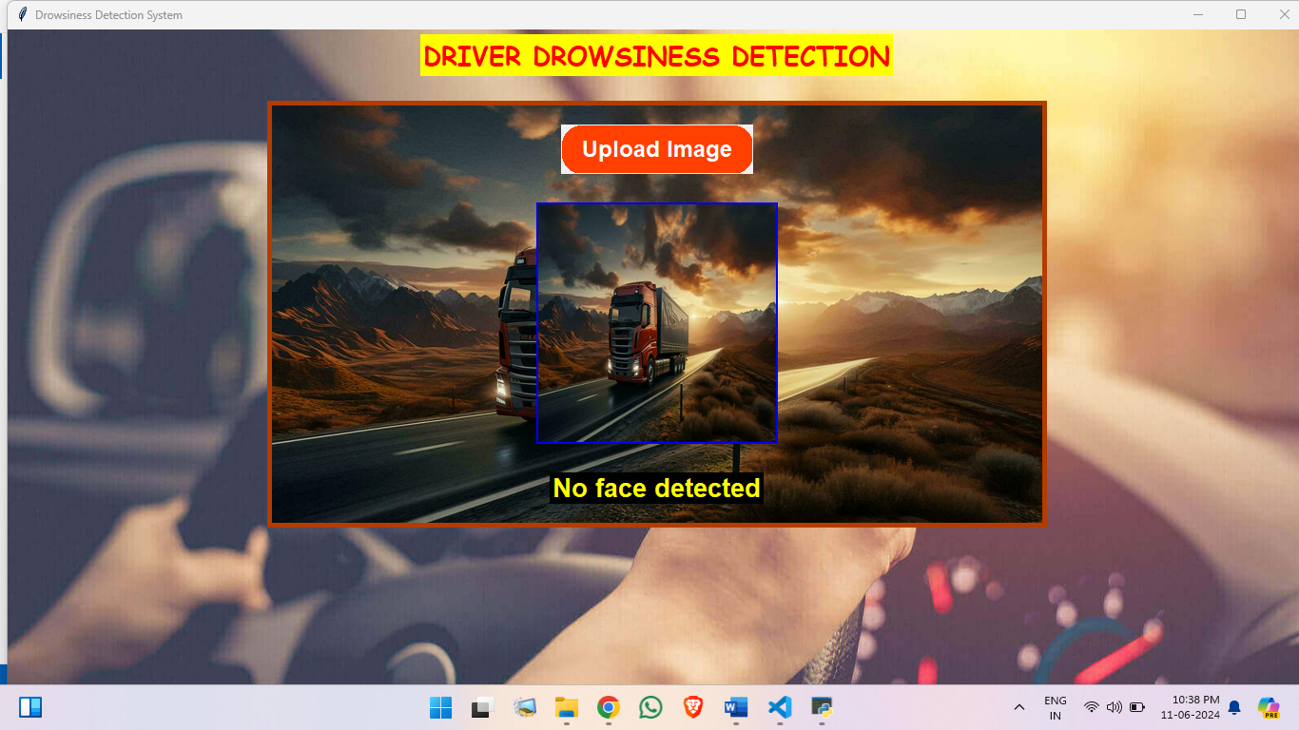
uploading no face image and detected

Slide 24
Conclusion
The drowsiness detection system project aims to enhance safety by alerting users when signs of drowsiness are detected. This comprehensive system integrates multiple components, including a user interface, image processing, drowsiness detection algorithms, and alert mechanisms, to provide a robust solution.

Slide 25
References
https://docs.djangoproject.com/en/4.1/
https://www.tidio.com/panel/dashboard
www.w3schools.com
www.wikipedia.com
www.tutorialspoint.com

Slide 26
Thank You!

